Slide 1


Cyber Security: Understanding Phishing Attacks
This presentation provides a comprehensive overview of phishing attacks, highlighting how to identify phishing emails and counterfeit websites. It delves into the tactics of social engineering that scammers use to manipulate victims, and offers practical best practices to help you safeguard yourself from these threats. By becoming aware and informed, we can significantly reduce the risk of falling prey to such deceptive schemes.
Internship Program : Cyber Security Task 2
Prepared by: Aayan Khan

Slide 2

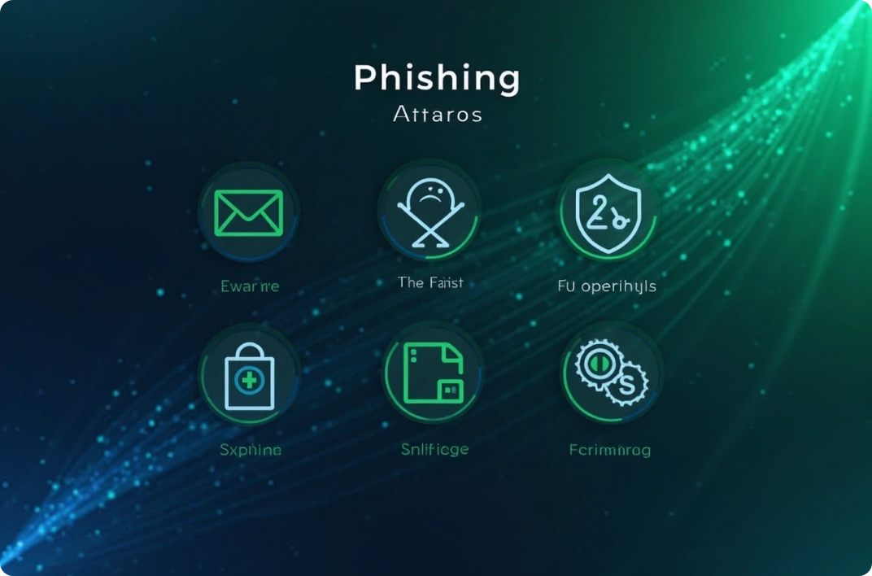

Understanding Phishing
What is Phishing?
Types of Phishing
Impact of Phishing
Phishing is a cyber attack that tricks individuals into providing sensitive information by impersonating legitimate organizations through fraudulent emails or websites.
Common types include email phishing, spear phishing (targeted), vishing (voice phishing), and smishing (SMS phishing), each using different methods to deceive victims.
Phishing can lead to identity theft, financial loss, and unauthorized access to sensitive data, making awareness essential for personal and organizational safety.

Slide 3






Recognizing Phishing Emails
2
Generic Greetings
Suspicious Sender Addresses
Phishing emails often use generic greetings like 'Dear Customer'.
1
Always check the sender's email closely.
Urgent Language
3
Look out for language that creates urgency, like 'Your account will be suspended!'.
Unusual Attachments or Links
5
Be wary of unexpected attachments or links; always verify URLs.
Poor Grammar and Spelling
4
Many phishing emails contain grammatical errors.

Slide 4



Identifying Fake Websites
Check the URL
Look for Contact Information
Verify Website Security
Ensure the website URL begins with 'https://' and check for misspellings.
Legitimate websites provide clear contact information.
Use tools to check website security and review online reviews.
Check for Trust Seals
Use Search Engines
Authentic websites often display trust seals from security companies.
Search for the company name along with 'scam' or 'fraud'.

Slide 5



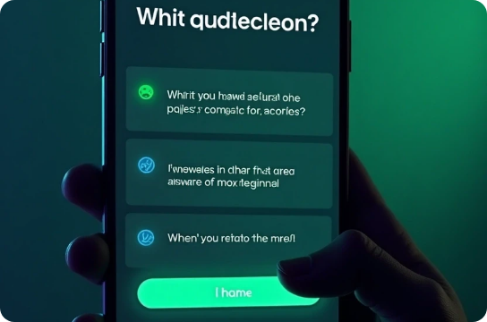

Social Engineering Tactics
Pretexting
Baiting
Tailgating
Attackers create a fabricated scenario to obtain information. For example, they may pose as IT support to gain access to sensitive data.
This involves enticing victims with free downloads or offers that lead to malware installation or data theft.
Physical access is gained by following an authorized person into a secure area, often seen in corporate environments.
Quizzes and Surveys
Impersonation
Attackers may use fake quizzes or surveys to gather personal information, making it seem harmless or entertaining.
Attackers might impersonate someone you know or trust, such as a colleague or friend, to gain your confidence and extract information.

Slide 6





Best Practices to Avoid Phishing
Verify Requests for Information
Educate Yourself and Others
Always verify requests for sensitive information by contacting the organization directly using known contact methods.
Regular training and awareness programs on phishing can significantly reduce the risk of falling victim to such attacks.
2
1
Use Multi-Factor Authentication
3
Enable multi-factor authentication (MFA) on your accounts to add an extra layer of security against unauthorized access.
5
Report Phishing Attempts
4
If you receive a phishing email, report it to your email provider and the impersonated organization to help combat these attacks.
Keep Software Updated
Regularly update your operating system, browsers, and security software to protect against known vulnerabilities and threats.

Slide 7





Real-World Examples of Cyber Threats
Target Data Breach (2013)
Google and Facebook Scam (2013-2015)
WannaCry Ransomware (2017)
Attackers used phishing emails to gain access to a third-party vendor, leading to a massive data breach affecting millions of customers.
This ransomware spread via phishing emails, impacting thousands of organizations worldwide, including the UK's National Health Service.
A Lithuanian man impersonated a supplier and tricked Google and Facebook into wiring over $100 million to fraudulent accounts.
Twitter Bitcoin Scam (2020)
COVID-19 Phishing Scams
High-profile Twitter accounts were compromised through phishing, leading to a Bitcoin scam that defrauded users of over $120,000.
During the pandemic, many phishing emails posed as health updates or vaccine information to steal personal data.

Slide 8







Interactive Quiz
1
Question 1
2
Question 2
What is a key indicator of a phishing email? (Options: A. Personalized greeting, B. Generic greeting)
How can you check if a website is secure ?
(Options: A. Look for 'http://', B. Look for 'https://')
3
Question 3
4
Question 4
What should you do if you receive a suspicious email?
(Options: A. Ignore it, B. Verify with the sender)
Which tactic involves creating a false scenario to obtain information? (Options: A. Baiting, B. Pretexting)
5
Question 5
What is one of the best practices to avoid phishing?
(Options: A. Use the same password everywhere, B. Enable multi-factor authentication)

Slide 9



Cyber Security Awareness Conclusion
Be Cautious
2
Approach unsolicited requests with suspicion.
Stay Informed
1
Continuous education on phishing and cyber security is vital.
3
Collaborate and Report
Share knowledge about phishing and report incidents.

